Slide 1

Doub less Living!
The Gospel of
LUKE
That you may have certainty!

Slide 2
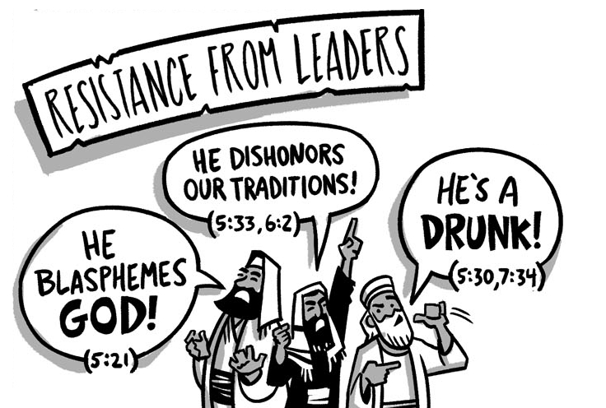

The Rise of Opposition
Four Controversies
Part One
Luke 5:27–32

Slide 3

What thoughts and feelings come to mind when you see this logo?

Slide 4

Controversy Over Association
Luke 5:27-32 (CSB)
²⁷ After this, Jesus went out and saw a tax collector named Levi sitting at the tax office, and he said to him, "Follow me." ²⁸ So, leaving everything behind, he got up and began to follow him.
²⁹ Then Levi hosted a grand banquet for him at his house. Now there was a large crowd of tax collectors and others who were guests with them. ³⁰ But the Pharisees and their scribes were complaining to his disciples, "Why do you eat and drink with tax collectors and sinners?"
³¹ Jesus replied to them, "It is not those who are healthy who need a doctor, but those who are sick. ³² I have not come to call the righteous, but sinners to repentance."
❶ What did Jesus say to Levi and how did he respond?
❷ What do people find most difficult to leave behind when they follow Jesus?
❸ What were Levi’s first actions as a new follower of Jesus?
Doub less Living! ©2019 Eric F. Glover

Slide 5
Controversy Over Association
Luke 5:27-32 (CSB)
²⁷ After this, Jesus went out and saw a tax collector named Levi sitting at the tax office, and he said to him, "Follow me." ²⁸ So, leaving everything behind, he got up and began to follow him.
²⁹ Then Levi hosted a grand banquet for him at his house. Now there was a large crowd of tax collectors and others who were guests with them. ³⁰ But the Pharisees and their scribes were complaining to his disciples, "Why do you eat and drink with tax collectors and sinners?"
³¹ Jesus replied to them, "It is not those who are healthy who need a doctor, but those who are sick. ³² I have not come to call the righteous, but sinners to repentance."
❹ Whom did Levi invite to his “new career” party?
❺ What controversy arose at the event?
Doub less Living! ©2019 Eric F. Glover

Slide 6
Controversy Over Association
Luke 5:27-32 (CSB)
²⁷ After this, Jesus went out and saw a tax collector named Levi sitting at the tax office, and he said to him, "Follow me." ²⁸ So, leaving everything behind, he got up and began to follow him.
²⁹ Then Levi hosted a grand banquet for him at his house. Now there was a large crowd of tax collectors and others who were guests with them. ³⁰ But the Pharisees and their scribes were complaining to his disciples, "Why do you eat and drink with tax collectors and sinners?"
³¹ Jesus replied to them, "It is not those who are healthy who need a doctor, but those who are sick. ³² I have not come to call the righteous, but sinners to repentance."
❹ Whom did Levi invite to his “new career” party?
❺ What controversy arose at the event?
Doub less Living! ©2019 Eric F. Glover

Slide 7
Controversy Over Association
Luke 5:27-32 (CSB)
²⁷ After this, Jesus went out and saw a tax collector named Levi sitting at the tax office, and he said to him, "Follow me." ²⁸ So, leaving everything behind, he got up and began to follow him.
²⁹ Then Levi hosted a grand banquet for him at his house. Now there was a large crowd of tax collectors and others who were guests with them. ³⁰ But the Pharisees and their scribes were complaining to his disciples, "Why do you eat and drink with tax collectors and sinners?"
³¹ Jesus replied to them, "It is not those who are healthy who need a doctor, but those who are sick. ³² I have not come to call the righteous, but sinners to repentance."
❻ What was the point of the Pharisees’ question?
Tax collectors were ceremonially unclean because:
They had frequent contact with Gentiles, and
They willingly served the Romans.
Doub less Living! ©2019 Eric F. Glover

Slide 8
Controversy Over Association
Luke 5:27-32 (CSB)
²⁷ After this, Jesus went out and saw a tax collector named Levi sitting at the tax office, and he said to him, "Follow me." ²⁸ So, leaving everything behind, he got up and began to follow him.
²⁹ Then Levi hosted a grand banquet for him at his house. Now there was a large crowd of tax collectors and others who were guests with them. ³⁰ But the Pharisees and their scribes were complaining to his disciples, "Why do you eat and drink with tax collectors and sinners?"
³¹ Jesus replied to them, "It is not those who are healthy who need a doctor, but those who are sick. ³² I have not come to call the righteous, but sinners to repentance."
❼ How did Jesus answer their question; what reason did He give for His willingness to meet with sinners?
Doub less Living! ©2019 Eric F. Glover

Slide 9
Controversy Over Association
Luke 5:27-32 (CSB)
²⁷ After this, Jesus went out and saw a tax collector named Levi sitting at the tax office, and he said to him, "Follow me." ²⁸ So, leaving everything behind, he got up and began to follow him.
²⁹ Then Levi hosted a grand banquet for him at his house. Now there was a large crowd of tax collectors and others who were guests with them. ³⁰ But the Pharisees and their scribes were complaining to his disciples, "Why do you eat and drink with tax collectors and sinners?"
³¹ Jesus replied to them, "It is not those who are healthy who need a doctor, but those who are sick. ³² I have not come to call the righteous, but sinners to repentance."
❼ How did Jesus answer their question; what reason did He give for His willingness to meet with sinners?
❽ What is the objective of Jesus’ mission?
Doub less Living! ©2019 Eric F. Glover

Slide 10
Controversy Over Association
Luke 5:27-32 (CSB)
²⁷ After this, Jesus went out and saw a tax collector named Levi sitting at the tax office, and he said to him, "Follow me." ²⁸ So, leaving everything behind, he got up and began to follow him.
²⁹ Then Levi hosted a grand banquet for him at his house. Now there was a large crowd of tax collectors and others who were guests with them. ³⁰ But the Pharisees and their scribes were complaining to his disciples, "Why do you eat and drink with tax collectors and sinners?"
³¹ Jesus replied to them, "It is not those who are healthy who need a doctor, but those who are sick. ³² I have not come to call the righteous, but sinners to repentance."
❼ How did Jesus answer their question; what reason did He give for His willingness to meet with sinners?
❽ What is the objective of Jesus’ mission?
Doub less Living! ©2019 Eric F. Glover

Slide 11
Jesus’ Outreach to Outcasts
Jesus sought out and intentionally associated with the outcasts of society as part of His mission.
Jesus sees in the outcast as an opportunity for God to show His grace and love.
Jesus didn’t flinch at upsetting traditions; His primary concern was the spiritual condition of those He met.
This passage exposes the deeply personal character of Jesus’ mission and challenges us to be more like Him.

Slide 12
Deliberate Discipleship
“Association with outcasts is a part of outreach – isolation from sinners is not the call of the disciple.” Darrell Bock
What traditions do you adhere to simply because they are traditions. Are they holding you back from sharing the love of Christ?
To whom in your life can you reach out to in the days ahead that others have neglected or ignored?

Slide 13


www.doubtlessliving.com

Slide 14
The Rise of Opposition
Four Controversies
Part Two
Luke 6:1-11

